Slide 1


Designing Trustworthy AI
for Developing Economies
Human Oversight Lessons from India
Dr Smrite Goudhaman
Global Professor of Practice, Golden Gate University, USA · Pre-Sales Solutions Leader, AI & Enterprise Transformation, Datamatics
Deployment:
Toscano Restaurant Chain, India · SafetyCulture Platform · 2024–2025 · n = 350 frontline workers
LIGHTNING TALK · 15 MINUTES · Transparency, Accountability & Human Oversight
Notes:
Good morning / afternoon, distinguished delegates.
My name is Smrite Goudhaman. I am a Professor of Practice at Golden Gate University and a Pre-Sales Solutions Leader in AI and Enterprise Transformation at Datamatics.
Today I am sharing evidence — not theory — from two years of longitudinal field research conducted at Toscano, a restaurant chain in India. The central question was simple: can AI-enabled training systems maintain and improve outcomes when they move from supervised pilots to operational scale?
The answer is yes. But only when human oversight, constrained AI design, and governance architecture are built in from the start.
This work directly serves the Dialogue's thematic cluster on transparency, accountability, and human oversight.

Slide 2



WHY THIS MATTERS
The Global Stakes — and Why Frontline Workers Are Central
40%
92M jobs displaced globally by 2030
Yet 170M new roles also projected — net gain depends on governance and reskilling.
of global jobs exposed to AI disruption
WEF Future of Jobs 2025 · weforum.org
IMF · Gen-AI: AI and the Future of Work (Jan 2024) · imf.org
Frontline workers: least protected
26%
High-churn service sectors bear greatest disruption with fewest reskilling resources.
WEF Future of Jobs 2025 · weforum.org
AI exposure in low-income countries — vs 60% in advanced economies
Trust is the governance bottleneck
IMF (2024) — same source above
AI adoption fails not on technology — but when trust, oversight & design are absent.
Goudhaman, Dahiya & Kumar (2026) · Paper ID 41
"Technology scales fast. Trust scales slowly. And this asymmetry is the central governance challenge of our era."
Sources: IMF SDN2024/001 (Jan 2024) imf.org/publications/sdn/issues/2024/01/14 · WEF Future of Jobs Report 2025 weforum.org/publications/the-future-of-jobs-report-2025
Notes:
Let me ground this in numbers — all from major international institutions.
The IMF's 2024 report on AI and the future of work found that 40 percent of global employment is exposed to AI disruption. But here is the critical inequality: in advanced economies that exposure is 60 percent, while in low-income countries it's only 26 percent. Lower exposure sounds safer — but the IMF is clear: these countries also lack the infrastructure and skills to capture AI's benefits, so the risk of widening inequality is severe.
Meanwhile the WEF's 2025 Future of Jobs Report projects 92 million jobs displaced globally by 2030 — and 170 million new ones created. Net positive — but only for workers who can reskill and transition. Frontline workers in high-churn service industries are least equipped to do so.
My research operates in exactly this space. And it shows that the governance design of AI systems — not the technology itself — is what determines whether workers trust and use them.

Slide 3
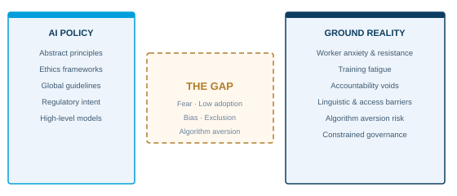
THE GOVERNANCE PROBLEM
Most AI governance frameworks remain abstract.
Frontline implementation exposes a different reality — one that policy must address.
What Frontline Deployment Exposes:
Fear and resistance to AI adoption
Low engagement & training fatigue
Algorithm aversion risk (Dietvorst et al., 2015)
Accountability gaps in live deployment
Digital exclusion of low-literacy workers
This study's evidence base: Two years of platform-generated behavioral data (SafetyCulture logs) from a real operational environment — moving AI governance from principle to longitudinal evidence. No self-report data. Objective behavioral trace only.
Governance treated as compliance burden
Algorithm aversion: Dietvorst, Simmons & Massey (2015) · doi.org/10.1037/xge0000033 | Human-AI guidelines: Amershi et al. (2019) · doi.org/10.1145/3290605.3300233
Notes:
Here is the governance paradox.
We have strong international frameworks — UNESCO's AI Recommendation, the EU AI Act, the OECD AI Principles, and now the GA Resolution that created this very Dialogue. These matter.
But when AI systems are deployed in a real restaurant with real staff and real service pressure, those frameworks become invisible. What workers experience is: confusion, anxiety, and — as Dietvorst and colleagues showed in 2015 — what researchers call algorithm aversion. Once you've seen an AI system make a mistake, you're inclined to abandon it entirely, even if it's objectively better than doing the task manually.
This is not a technology failure. It is a governance failure. And it is what my research set out to solve.

Slide 4
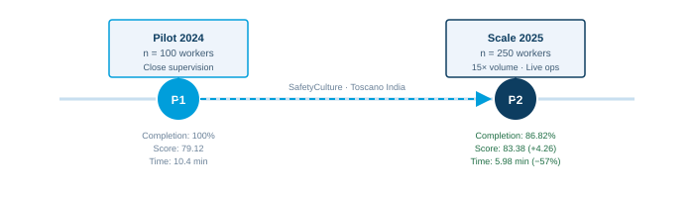
RESEARCH CONTEXT
Two-Phase Longitudinal Study: Toscano Restaurant Chain, India
PHASE 1 · 2024
100 frontline workers
Controlled doctoral pilot
Direct managerial oversight
Supervisory-led deployment
PHASE 2 · 2025
250 frontline workers
Live operational workflows
15× training volume increase
Reduced direct supervision
AI governance primary layer
AI Micro-Agent Functions (3 constrained modes only — Amershi et al., 2019):
① Reminders — timed completion notifications
② Pacing Cues — adaptive content sequencing based on learner progress
③ Reinforcement Nudges — post-assessment feedback supporting correct responses
Data: Platform-generated behavioral logs only — completion records, assessment scores (% correct), time-on-task per module. No self-report. Common method bias addressed per Podsakoff et al. (2003). Configuration and content held constant across both phases.
Source: Goudhaman, Dahiya & Kumar (2026) · CERE 2026 IIM Indore Paper ID 41 | Platform: SafetyCulture | Methodology follows Podsakoff et al. (2003) doi.org/10.1037/0021-9010.88.5.879
Notes:
Let me walk you through the study design precisely.
Toscano is a casual-dining restaurant chain operating across multiple branches in India. It is a real operational environment — high employee churn, tight onboarding windows, and service quality directly tied to how well staff are trained.
Phase One, in 2024, was a supervised doctoral pilot with 100 frontline workers. Close managerial control. Direct supervisory involvement.
Phase Two, in 2025, scaled to 250 workers in live operational conditions. Training volume increased 15 times. Direct supervision was deliberately reduced, placing AI governance architecture — not human supervisors — as the primary management layer.
The AI micro-agents had exactly three functions: reminders, pacing cues, and reinforcement nudges. Nothing else. They could not assign training, make exceptions, or escalate issues. Those remained human responsibilities.
All data came from platform behavioral logs. No surveys. No self-report. Objective, continuous, bias-minimal evidence.

Slide 5
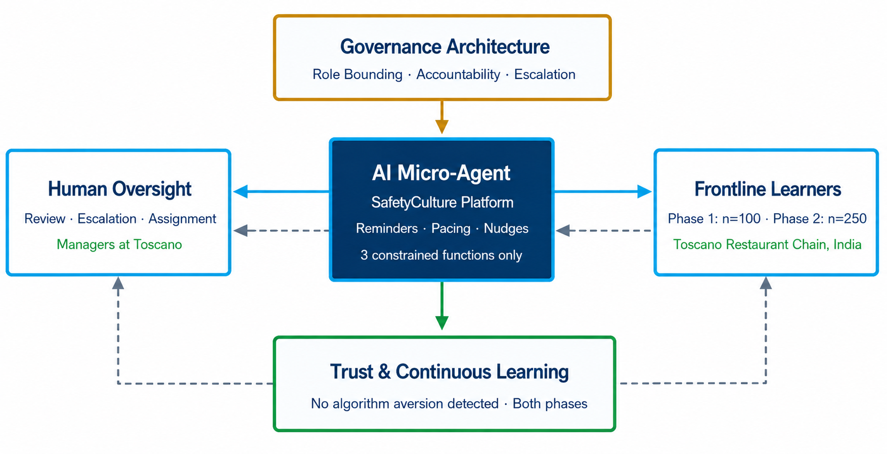




THE GOVERNANCE FRAMEWORK
Human Oversight Architecture — Constrained Agency in Practice
Governance Pillars:
Human Review
All AI outputs subject to manager review
Role Bounding
AI restricted to 3 task functions only
Escalation
Exception-handling stays with humans
Audit Trails
Platform logs as accountability evidence
New Theoretical Contribution — "Constrained Agency": AI decision-making authority deliberately restricted to specific, low-stakes task-level functions. All higher-order decisions (assignment, escalation, exceptions) remain exclusively with human managers. Builds on Hemmer et al. (2025) and Amershi et al. (2019).
Trust by Design
No aversion detected — either phase
Theoretical basis: Amershi et al. (2019) doi.org/10.1145/3290605.3300233 · Hemmer et al. (2025) doi.org/10.1080/0960085X.2025.2475962 · Fügener et al. (2019) doi.org/10.2139/ssrn.3368813
Notes:
This is the governance architecture that made our results possible.
I call the central theoretical concept "constrained agency." It's a new framework we propose in this paper: AI authority is deliberately role-bounded to specific, low-stakes task functions. Human managers retain all higher-order decision-making.
Why does this matter? Research by Dietvorst and colleagues shows that algorithm aversion — workers abandoning AI systems — typically occurs when AI oversteps. When it makes high-stakes calls without context. When it feels evaluative rather than supportive.
By constraining AI to reminders, pacing, and reinforcement nudges — and keeping assignment authority, exception handling, and escalation with human managers — we created a system where AI was experienced as an ally, not a replacement.
The governance lesson is architectural: role design determines trust outcomes. This builds on Amershi's 2019 Human-AI Interaction Guidelines and Hemmer and colleagues' 2025 work on human-AI complementarity.

Slide 6
FINDINGS — DATA FROM PAPER (ALL FIGURES EXACT)
What the Evidence Shows: Pilot (2024, n=100) vs. Scale (2025, n=250)
Metric
Pilot 2024
n=100
Scale 2025
n=250
Change & Interpretation
Completion Rate
(H1 — Adoption)
100%
86.82%
−13.18% · Operational normalization, not disengagement.
Above 85% threshold. AI micro-agents sustained adoption
despite 15× volume. H1 SUPPORTED ✓
Assessment Score
(H2 — Quality)
79.12 pts
83.38 pts
+4.26 pts · Deeper learning at scale despite reduced
supervision. AI reinforcement cues drove consolidation.
H2 SUPPORTED ✓
Time-on-Task
(H3 — Efficiency)
10.4 min
5.98 min
−4.42 min (−57%) · Learning fluency & efficiency gain.
Inverse correlation with quality = Inverse Learning Paradox.
H3 SUPPORTED ✓
Algorithm Aversion
(H4 — Trust)
None detected
None detected
No aversion across either phase. Governance structures
sustained continuous AI engagement. Managerial
oversight was the trust anchor. H4 SUPPORTED ✓
INVERSE LEARNING PARADOX: Scores rose +4.26 pts while time-on-task fell 57%. Speed and learning depth are not in conflict — they are complementary when AI is constrained and governed.
All figures: SafetyCulture platform behavioral logs 2024–2025 · Toscano Restaurant Chain India · Goudhaman, Dahiya & Kumar (2026) CERE IIM Indore Paper ID 41
Notes:
Let me now present the evidence — and I want to be precise, because every figure here comes directly from SafetyCulture's behavioral logs, not from surveys.
Completion rate fell from 100% to 86.82% — this sounds like a failure. It is not. It is operational normalization: the entirely expected result of moving from a controlled doctoral study to a live service environment with high staff churn. Critically, it remains above our 85% threshold even with a 15-times increase in training volume. H1 supported.
Assessment scores improved — from 79.12 to 83.38, a gain of 4.26 points — at scale, with less supervision than in the pilot. This directly contradicts the expectation that reducing oversight would harm quality. H2 supported.
Time-on-task fell 57%, from 10.4 minutes to 5.98 minutes per module. This is what we call the Inverse Learning Paradox. Conventional instructional design assumes faster completion means shallower learning. Our data completely contradict that assumption. We propose "accelerated consolidation" — learners internalizing AI cues and reducing extraneous cognitive load, allowing faster, more reliable encoding. H3 supported.
And critically: no algorithm aversion was detected in either phase. The human oversight architecture — role bounding, escalation pathways, managerial accountability — served as the trust anchor that prevented the aversion pattern. H4 supported.

Slide 7



GLOBAL REFRAMING
What Developing Economies Contribute to AI Governance
"Developing economies are not "behind." They are designing adaptive, resilient,
human-centred AI governance under real-world constraints — and the world must learn from them."
Workforce Inclusion
Multilingual Realities
Low-Resource Innovation
AI designed for workers across education levels, languages, and digital literacy — not just skilled users
High-churn, diverse, multilingual frontline workforces as a design constraint — not an edge case
Trustworthy AI built under budget and infrastructure pressure — replicable globally
Adaptive Governance
Human-First Design
Resilient AI Models
Governance that bends to operational context — not uniform top-down templates
Workers as active participants in trust-building — not passive subjects of AI transformation
AI deployment stress-tested by real-world complexity, churn, and scale — as in our study
IMF (2024): Developing economies at lower AI exposure but also lower capacity to benefit — raising inequality risk · imf.org/en/blogs/articles/2024/01/14
Notes:
I want to challenge a framing that persists in global AI governance discussions, including — respectfully — in many UN processes.
Developing economies are consistently positioned as recipients of AI governance. Places where frameworks designed in Geneva, Brussels, or Washington are transferred and localized.
This framing is both wrong and counterproductive.
India, Brazil, Kenya, Indonesia — these nations are not AI latecomers. They are designing AI governance for the most complex conditions on earth: multilingual workforces, variable digital literacy, high churn, limited budgets, and genuine operational pressure.
The solutions that work here — constrained agency, human-in-the-loop architecture, platform behavioral auditing — are precisely the models that global governance frameworks need.
The IMF's own 2024 report acknowledges that low-income countries face a compounded disadvantage: less immediate disruption, yes, but also less capacity to harness AI's benefits. The governance conversation must include the voices and models emerging from these contexts.
My study contributes exactly that: a replicable, evidence-based playbook from the ground.

Slide 8


POLICY RECOMMENDATIONS
Five Principles for Trustworthy AI Deployment at Scale
Grounded in longitudinal behavioral evidence — each linked to a finding in this study.
01
Mandate Human Oversight Architecturally
Embed review, escalation, and role bounding into deployment design — not as audit, but as structure. Finding: governance architecture prevented algorithm aversion across both phases.
02
Measure Trust & Efficiency — Not Just Completion
Completion rates alone are insufficient. Track assessment quality and time-on-task to distinguish mastery from compliance. Finding: completion fell 13% while quality rose +4.26 pts.
03
Include Frontline Workers in Governance Design
Frontline learners are stakeholders, not end-users. Agency over pacing and escalation rights sustained engagement without aversion. This is structural trust-building, not soft policy.
04
Apply Constrained Agency as a Design Principle
Restrict AI authority to specific, low-stakes task functions. Higher-order decisions must remain human-held. Role bounding is the difference between assistive scaffolding and threatening automation.
05
Treat AI Governance as Operational Practice — Not Policy Document
Governance must live in platform architecture, manager training, data infrastructure, and review cycles. Our pilot-to-scale playbook is replicable in healthcare, retail, manufacturing.
Recommendations grounded in: Goudhaman, Dahiya & Kumar (2026) · Amershi et al. (2019) · Hemmer et al. (2025) · Baldwin & Ford (1988) · Venkatesh et al. (2003)
Notes:
Five actionable governance principles emerge from this study — each linked to a specific empirical finding.
First: mandate human oversight architecturally. The absence of algorithm aversion in our study is directly attributable to governance design — not the AI technology itself.
Second: expand the measurement framework. Completion rates tell us people showed up. Assessment scores and time-on-task tell us whether learning actually happened. Governance frameworks — including any framework emerging from this Dialogue — must specify richer success metrics.
Third: include frontline workers in governance design. This study gave workers agency over their own pacing. That agency prevented aversion. Participation in governance loops is not consultation — it is trust infrastructure.
Fourth: apply constrained agency. Role bounding AI to low-stakes functions is the mechanism by which AI becomes assistive rather than threatening. This is a design principle, not a regulatory constraint.
Fifth: make governance operational. The most sophisticated policy framework achieves nothing if it lives only in a resolution. It must be embedded in procurement criteria, manager training, platform configuration, and review cycles.

Slide 9
Closing Reflection
"The future of AI governance will not be decided only in laboratories or policy rooms.
It will be decided where people learn, work, struggle, adapt — and choose to trust."
This Study Demonstrated:
86.82%
+4.26 pts
−57%
Completion at scale
(above 85% threshold)
Assessment gain
(quality improved at scale)
Time-on-task reduction
(accelerated consolidation)
Source: Goudhaman, Dahiya & Kumar (2026) CERE 2026 · IIM Indore · Paper ID 41 · SafetyCulture behavioral logs 2024–2025
Trustworthy AI is not built through automation alone.
It is built through human dignity, constrained design, oversight, and inclusion.
Goudhaman, Dahiya & Kumar (2026) · CERE 2026 IIM Indore Paper ID 41 | IMF (2024) sdnea2024001 | WEF Future of Jobs 2025
Notes:
I want to close with something the data supports — and something I believe deeply.
The governance decisions made in this room have consequences for millions of workers who will never be in a room like this one. Workers at Toscano in India. At a garment factory in Bangladesh. At a clinic in Kenya. At a hospitality company in São Paulo.
They are not AI experts. They are not governance specialists. But they are the people whose trust — or distrust — will determine whether AI systems actually work.
What this study shows is that trust is achievable. Not through better algorithms. Through better governance design.
86.82% adoption at 15-times scale. A 4.26-point quality gain. A 57% efficiency improvement. No algorithm aversion detected. All four hypotheses supported.
These numbers did not emerge from the technology. They emerged from the architecture — human oversight, constrained agency, role clarity, platform accountability.
Trustworthy AI is not built through automation alone. It is built through human dignity, constrained design, oversight, and inclusion.
Thank you.

Slide 10
Thank You
Dr Smrite Goudhaman
Global Professor of Practice · Golden Gate University, USA
Pre-Sales Solutions Leader, AI & Enterprise Transformation · Datamatics
Notes:
Thank you.
I welcome questions on the governance framework, the empirical findings, or the policy recommendations.
The full paper is: Goudhaman, Dahiya & Kumar (2026) — From Pilot to Scale — CERE 2026, IIM Indore, Paper ID 41.
The official UN conference report — the Draft Note on Themes and Structure — is available at the link shown. Your talk directly addresses Cluster 4: Transparency, Accountability and Human Oversight.
I am open to collaboration with any member states, international organizations, or research institutions working on inclusive AI governance frameworks.

